Slide 1
Benefits Offered Across the San Francisco Job Market
Christian Attard
Varsha Ramamurthy

Slide 2
Data Wrangling Techniques
The source dataset was obtained from Kaggle, titled “SF Salaries”
The description on Kaggle was geared towards learning more about the San Francisco government by looking at its employees and their salaries and benefits offered in USD
After downloading the csv and sqlite files from the “SF Salaries” dataset, the following wrangling techniques were applied
The csv and sqlite files were visualized using D3 and plotly libraries
An interactive D3 scatter plot was used to visualize the non-null columns of the csv file; the null entries of the benefits column were changed to ‘0’
An interactive plotly pie and chart was used to visualize data on each employee in the database
A leaflet visualization of the city of San Francisco, with a popup depicting the area and population of the city was designed

Slide 3
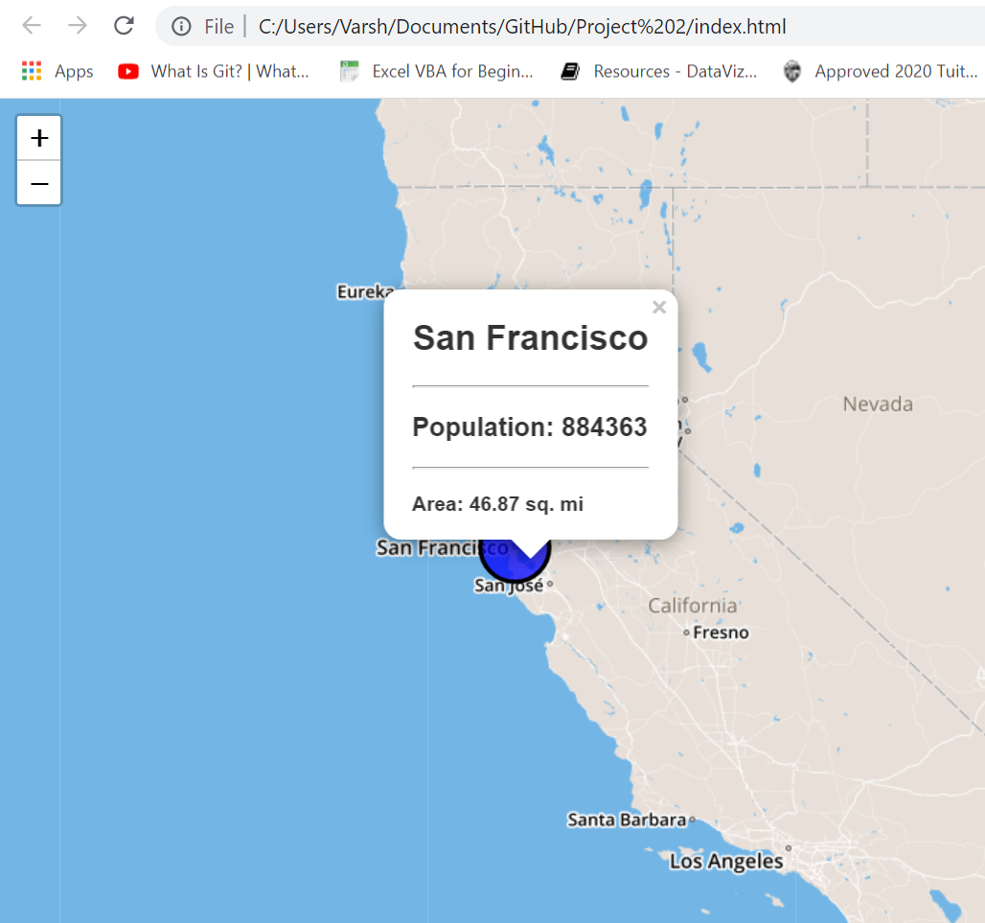
Leaflet Visualization of San Francisco
A circle marker was designed to appear on the San Francisco coordinates, with the size of the area of the city
The pop-up shown depicts the population and area of San Francisco

Slide 4
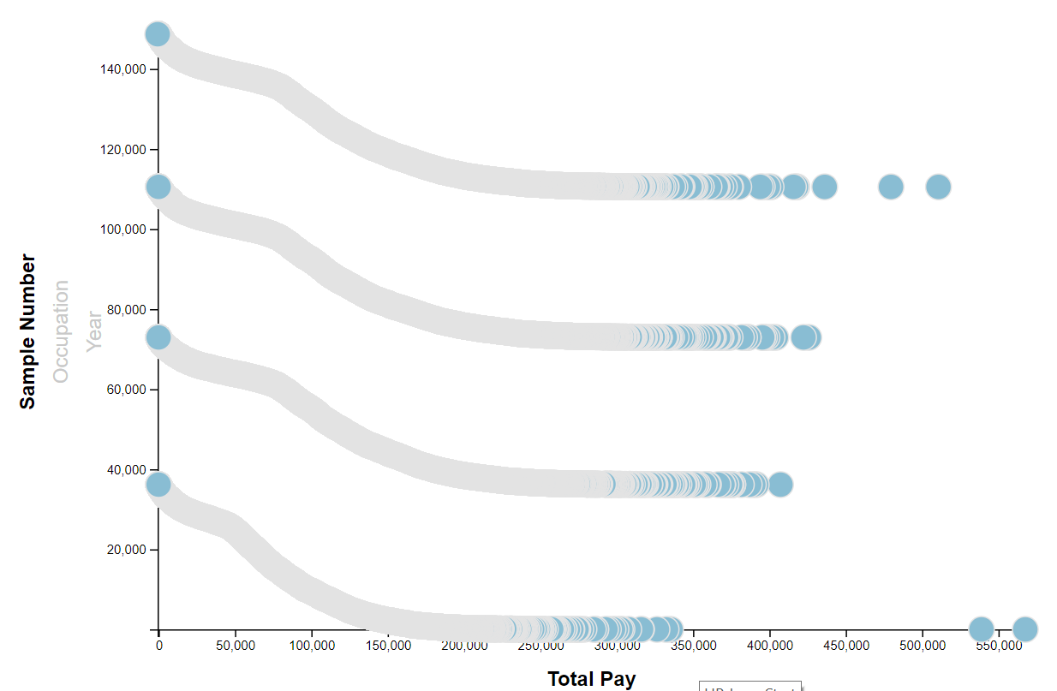
Sample Member vs Annual Income
The sample members in order go from 2011-2014
Although a downward trend is observed, given the axes, it can be inferred that there is a consistent increase in annual income as the years progress

Slide 5
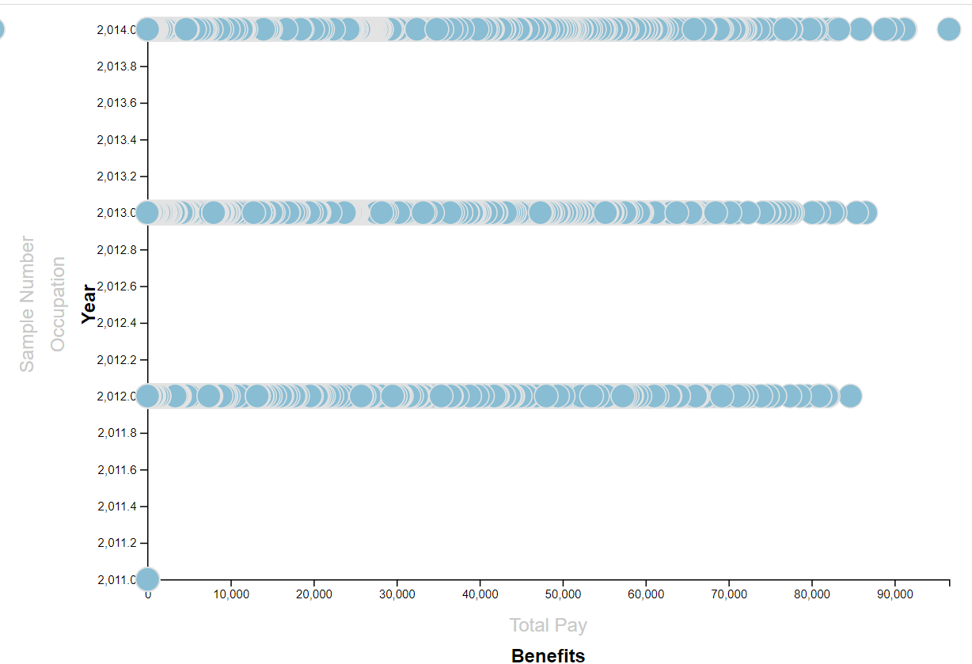
Benefits vs Year
It can be observed that benefits were close to zero in 2011, and consistently increased as the years progressed
The benefits market in San Francisco has improved over the years, with more jobs offering benefits

